Slide 1
Data tidying in R

Slide 2
Principles of reproducibility
The raw data should never be altered
Every step from the raw data to the clean data should be done in code
Every step from the clean data to the analysis/plotting should be done in code
Ideally, human hands should never touch the data
Notes:
i.e. no ‘find and replace’ or sorting in excel, no removing cases in SPPS, no sorting.

Slide 3
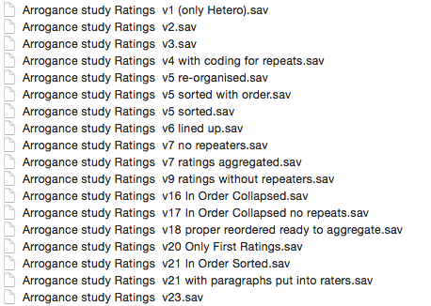
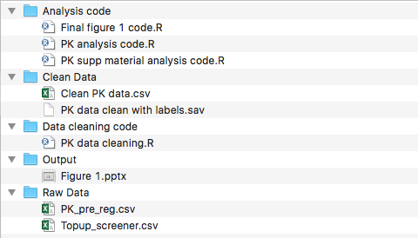
Reproducible versus not
Not reproducible
Reproducible

Slide 4
Principles of tidy data
Each variable forms a column
Each observation forms a row
Each value is placed in its own cell

Slide 5
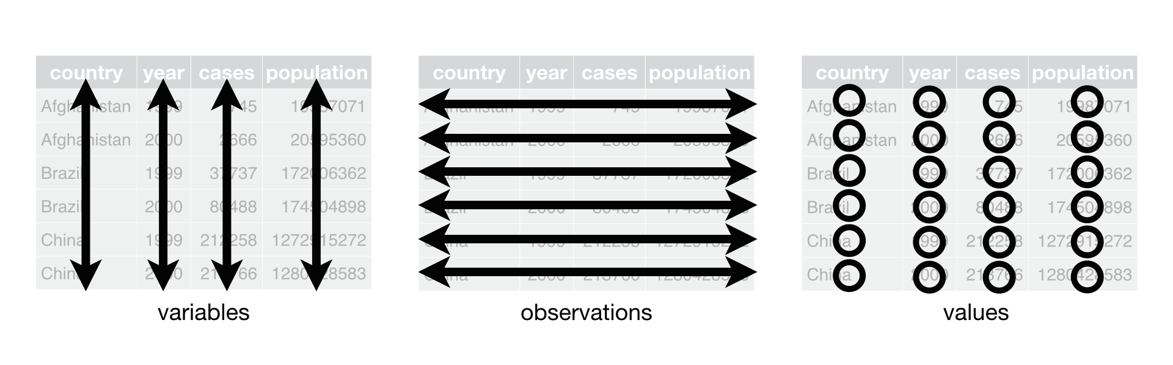
Tidy data
e
Notes:
This might seem trivial, until you define what you mean by variables and observations and realise that most of the time, data is not tidy. There might be hidden values in our variable names that really should have their own value. There might be multiple variables in a single column. There might be variables in rows and variables in columns.

Slide 6


Slide 7
Sadness impairs colour perception
“The results of both studies showed that sadness impaired colour perception along the blue-yellow axis but not along the red-green axis”

Slide 8
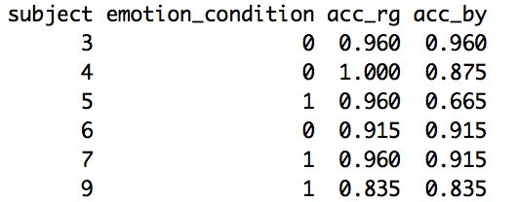
Colour perception data
t.test(acc_by ~ emotion_condition, data = colour)
t.test(acc_rg ~ emotion_condition, data = colour)

Slide 9
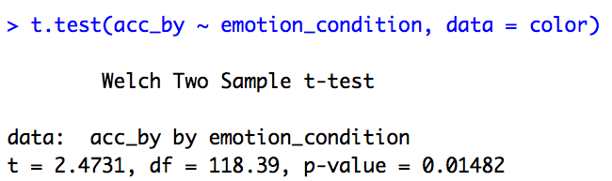
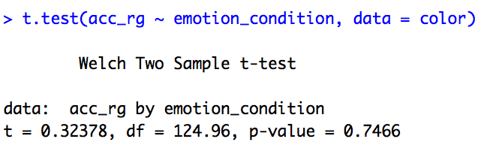
Results reported in the paper

Slide 10
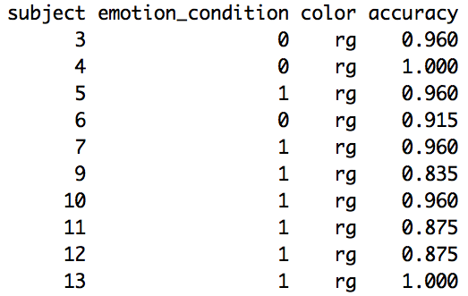
Need long data to test interactions
lm(accuracy ~ emotion_condition*color)

Slide 11
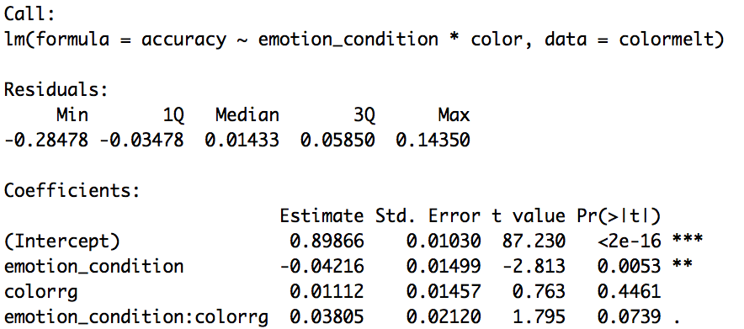
Interaction results
Paper retracted after multiple people noticed this

Slide 12
Why do we care?
For most of what we want to do in R, tidy data is the optimal format
Principles provide a universal language to express data problems, which make it easier to figure out what needs to happen to make the data tidy.
Helps you to realise what information you need for modelling.

Slide 13
Common data problems
Column headers hold values, not just variables
Multiple variables stored in one column
(or) one variable across multiple columns
Variables are stored in rows instead of columns
Notes:
Or any combination of the above.
Also, multiple types of units in one table (not usually a problem for us, that’s what we want) or a single observational unit spread across multiple tables. But these three I feel are all defined by the observation/variable/row complex so they sort of sit together.

Slide 14
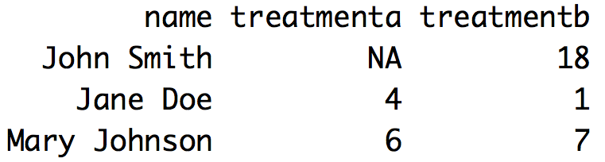
#1: Column headers hold values, not just variables
Color data
Most longitudinal data

Slide 15
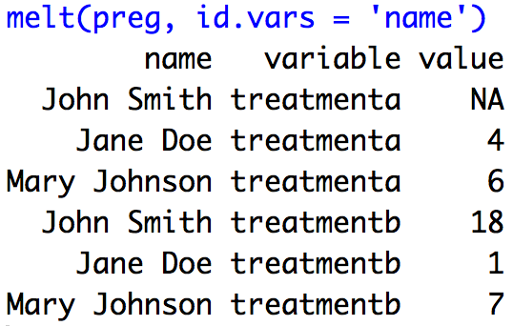
#1: Column headers hold values, not just variables

Slide 16
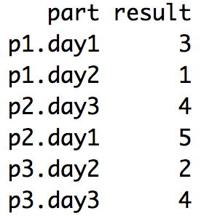
#2a: Multiple variables stored in one column

Slide 17
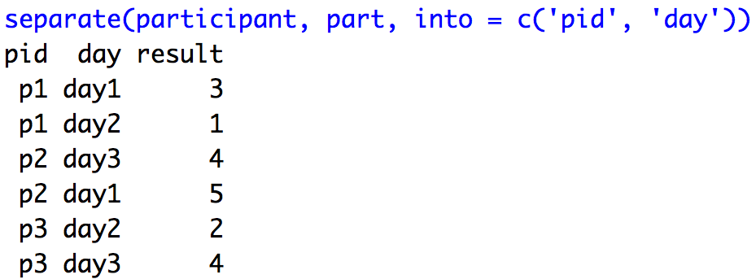
#2a: Multiple variables stored in one column

Slide 18
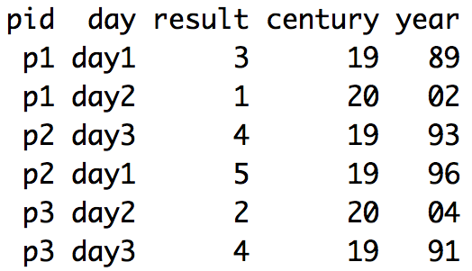
#2b: One variable stored in multiple columns

Slide 19
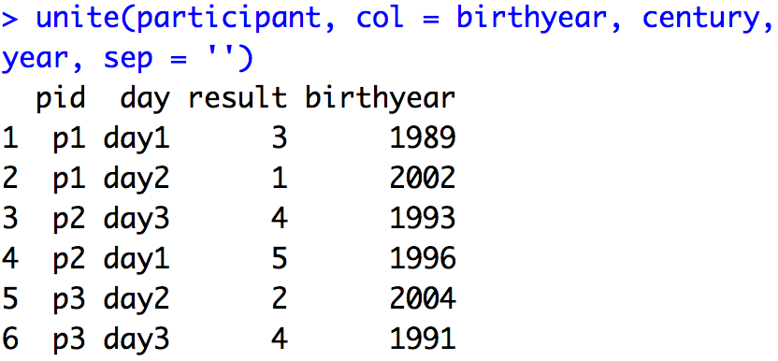
#2b: One variable stored in multiple columns
Notes:
Unite is sort of the dorky younger brother of separate. It’s much easier to combine columns with other R functions like + for numeric values, or paste for everything. However, if we ever have one variable spread out across more than 2 columns, unite is usually the fastest way to go, and it’s worth knowing for symmetry’s sake.

Slide 20
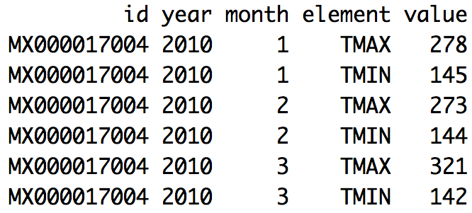
#3: Variables are stored in rows instead of columns

Slide 21
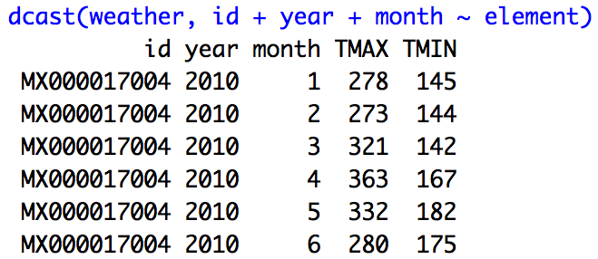
#3: Variables are stored in rows instead of columns
Notes:
Whether something is a value or a variable depends on your research question, really. Here we think Tmax and Tmin are variables, not values, because we want to treat them separately, essentially. We can use them to calculate their difference or mean. But we’re not treating them as different ‘conditions’ of temperature.

Slide 22
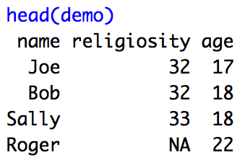
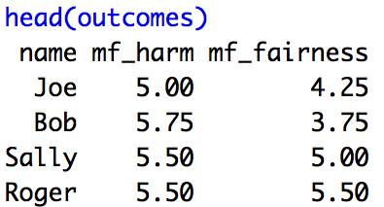
#4 Observations are split across multiple data frames

Slide 23
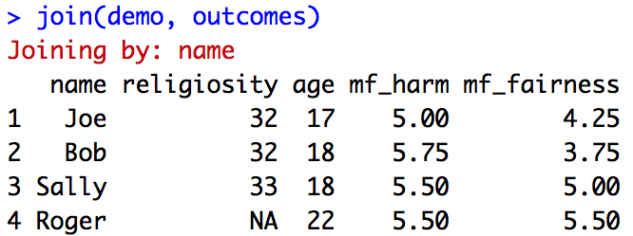
#4 Observations are split across multiple data frames

Slide 24
Tidying functions
melt: Takes multiple column headers and ‘stacks’ them on top of one another into a single column.
dcast: The opposite of melt. Takes a long column(s) containing a series of values and ‘spreads’ them out or ‘unstacks’ them so each value becomes a column header.

Slide 25
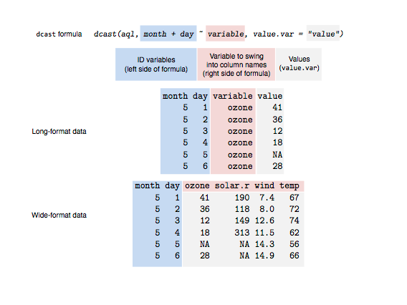
dcast visually
Notes:
Credit to Sean Anderson for the image (http://seananderson.ca/2013/10/19/reshape.html)

Slide 26
Tidying functions
separate: Takes a column containing multiple variables and separates them out into their own columns.
unite: The opposite of separate. Takes a number of columns containing a single variable, and brings them together into one column
join: Brings together multiple data frames, matching based on shared variable names

Slide 27
Combination problems
In many cases (e.g. complicated longitudinal data, ratings data, or within-subjects designs) all three problems will occur at various stages of cleaning.
We’ll solve them all in sequence, using each tool at the appropriate stage.
Most data messiness problems can be expressed as some combination of these problems, and so can be solved with these four tools

Slide 28
Further reading
http://vita.had.co.nz/papers/tidy-data.html

Slide 29
String functions
Tidying data often requires us to manipulate strings (e.g. ‘SU44_C’) in various ways.
We might want to extract a certain part of the string - perhaps that 44 represents a trial number
We might want to replace part of a string with something else, or with nothing, deleting it if it’s extraneous

Slide 30
Stringr
Package from the author of our other data cleaning packages (Hadley Wickam)
Makes string functions uniform and easy
Same format for each function

Slide 31
Stringr
str_replace(string, pattern, replacement)
Searches the vector specified in string, and replaces any occurrences of pattern with the specified replacement
str_extract(string, pattern)
Searches the vector specified in string, and returns a new vector containing matches to pattern

Slide 32
Regular expressions
What makes stringr so powerful is the use of regular expressions, known as regex
Patterns similar to advanced google search
E.g. the . means ‘anything’, the * means ‘repeated any number of times’

Slide 33
Regular expressions
SU44_C
^[A-Z]* would match the ‘SU’
[0-9]* would match the 44
[A-Z]$ would match the ‘C’

Slide 34
Regular expressions
Though we won’t have time to learn them in class, regular expressions are very quick to learn on your own and quite worthwhile.
Try https://regexone.com/ for a half hour tutorial
And http://www.regular-expressions.info/ for a comprehensive reference table

Slide 35
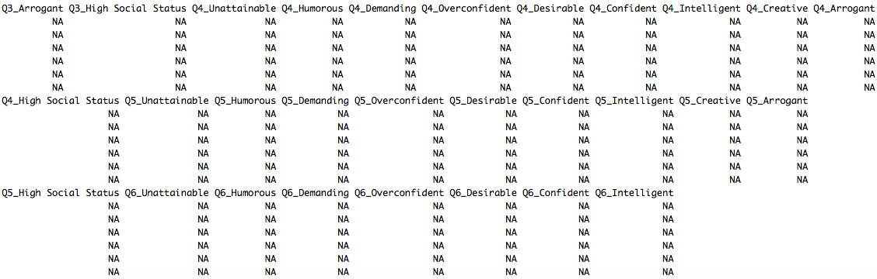
Data cleaning example
Notes:
Messy data from the start of my PhD. Had ~450 dating profiles rated by 8 Mturkers each on 8 traits. The column headers contain the ID of the dating profile author, and the variable they were rated on. Unfortunately, I manually scrambled the other in which traits were rated in blocks across the dataset, so it was very hard to calculate averages using SPSS or excel.
This dataset had 4511 columns.

Slide 36
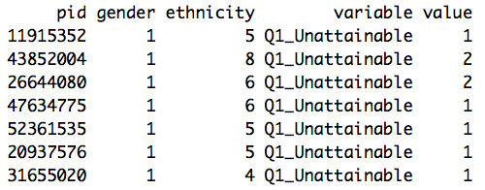
Data cleaning example
melt(test, measure.vars = grep('Q[0-9]*_[ACHOSUDI]', colnames(test)), na.rm = TRUE)
This command uses simple regular expressions and grep to find the column names of my rating variables, using those as measure.vars, the opposite of id.vars. It solves problem #1 by melting my column headers into a variable.
Notes:
Messy data from the start of my PhD. Had ~450 dating profiles rated by 8 Mturkers each on 8 traits. The column headers contain the ID of the dating profile author, and the variable they were rated on. Unfortunately, I manually scrambled the other in which traits were rated in blocks across the dataset, so it was very hard to calculate averages using SPSS or excel.
This dataset had 4511 columns.

Slide 37
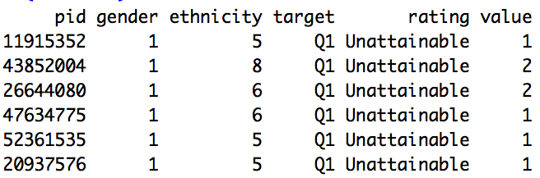
Data cleaning example
testmelt <- separate(testmelt, variable, into = c('target', 'rating'), sep = '_')
This command uses separate to extract my author ids (target) from the rating variable (rating), solving problem #2
Notes:
Messy data from the start of my PhD. Had ~450 dating profiles rated by 8 Mturkers each on 8 traits. The column headers contain the ID of the dating profile author, and the variable they were rated on. Unfortunately, I manually scrambled the other in which traits were rated in blocks across the dataset, so it was very hard to calculate averages using SPSS or excel.
This dataset had 4511 columns.

Slide 38
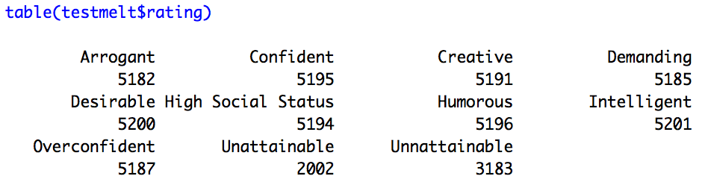
Data cleaning example
Using the table command to see frequencies on my new rating variable, I notice that I have two spellings of unattainable. This will create two half-full columns when I cast the data, something I don’t want.
Notes:
Messy data from the start of my PhD. Had ~450 dating profiles rated by 8 Mturkers each on 8 traits. The column headers contain the ID of the dating profile author, and the variable they were rated on. Unfortunately, I manually scrambled the other in which traits were rated in blocks across the dataset, so it was very hard to calculate averages using SPSS or excel.
This dataset had 4511 columns.

Slide 39
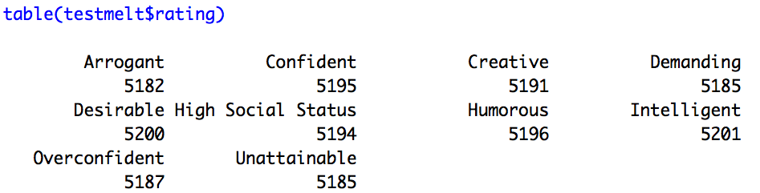
Data cleaning example
testmelt$target <- str_replace(testmelt$target, 'Q', ‘')
testmelt$rating <- str_replace(testmelt$rating, 'Unn', ‘Un')
Using str_replace, I fix the error, and while I’m at it, remove the Q from the target variable. Now that my values are correct, I’m ready to cast the data
Notes:
Messy data from the start of my PhD. Had ~450 dating profiles rated by 8 Mturkers each on 8 traits. The column headers contain the ID of the dating profile author, and the variable they were rated on. Unfortunately, I manually scrambled the other in which traits were rated in blocks across the dataset, so it was very hard to calculate averages using SPSS or excel.
This dataset had 4511 columns.

Slide 40
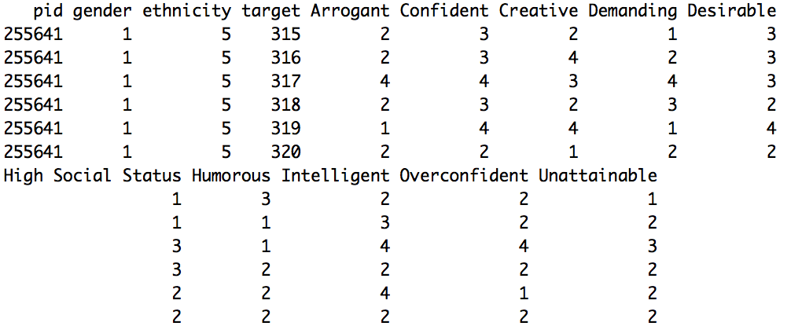
Data cleaning example
testcast <- dcast(testmelt, ... ~ rating)
Here I use dcast to cast, or ‘widen’ my data. The … stands for ‘everything else’, so I’m basically saying that everything but rating is an id variable, which should form a row, and that the contents of the rating column should be ‘spread out’ into their own columns.
The data are now in perfect format for multilevel modelling. Or, if I wanted to, I could use aggregate to get an average score for each target on each trait, and use normal regression
Notes:
Messy data from the start of my PhD. Had ~450 dating profiles rated by 8 Mturkers each on 8 traits. The column headers contain the ID of the dating profile author, and the variable they were rated on. Unfortunately, I manually scrambled the other in which traits were rated in blocks across the dataset, so it was very hard to calculate averages using SPSS or excel.
This dataset had 4511 columns.

Slide 41
The power of R
In this example, 6 lines of code took us from incredibly difficult and messy data to clean, ready to analyse data
When I first got this data, it took me days to tidy it up in excel
Mastery of these data tidying tools can be extremely useful

Slide 42
Complexity versus efficiency
I should offer a word of warning though. R offers many tools (like the ones I’ve showed you) that are very powerful, in that they can do a lot in a single line of code
However, the more powerful a function, the more important it is to understand it, because more is happening ‘behind the scenes’

Slide 43
Complexity versus efficiency
For a long time I used tools like melt and dcast with a vague understanding and a lot of trial and error, tweaking the code until it did what I wanted. I often still do the same with graphing.
It’s fine to take that approach. But when you’re using tools you don’t fully understand yet, it’s even more important to check the results and make sure it actually did what you want. Functions like nrow, ncol, and table are useful for this.
It’s always a good idea to use the head() and tail() functions after you transform your data to see what you did. Never run analyses without at least looking at the underlying data.

Slide 44
Complexity versus efficiency
As you get more experienced with R, you will learn to code more efficiently and use powerful functions (and write your own) to do things quickly
But at the start it’s fine to learn and understand a handful of functions and use those, even if it involves writing more lines of code
Prioritise making sure you understand what your code is doing

